Slide 1

























Initial state of
particles provided
BEGIN
$$T=0$$
Read initial particle state
Read in simulation
parameters
$$N, L, r, S, print/perf$$
Print details of
all particles
$$T≤S$$
Initialise particles with
random positions and
velocities using a uniform
distribution
Initial state of
particles not provided
$T=S$ or $print$
EXIT
io.c
$$T=1→S$$
$$T>S$$
simulator.c
Advance time step $T$
Observe all operations here are read-only, except for addition of collision candidates into a common array
$$i=1→N$$
$$T≤S$$
Consider particle $p_{i}$
$$i≤N$$
Check if particle $p_{i}$
collides with a wall
Yes
Add collision candidate
into candidates array
$$i>N$$
$$j=i→N$$
No
Array of all possible
collisions during this
time step is fully built
Consider particle $p_{j}$
Check if particle $p_{i}$
and $p_{j}$ collide
No
Yes
Add collision candidate
into candidates array
Sort all $N_{c}$ collision candidates
by a pre-defined total ordering
$$i=1→N_{c}$$
Particle(s) in $C_{i}$ have
not collided for this time step
filter.c
Consider collision
candidate $C_{i}$
$$i≤N_{c}$$
Mark particle(s) involved in $C_{i}$ as collided for this time step
$$i>N_{c}$$
Particle(s) in $C_{i}$ have
already collided in an
earlier collision
Resolve all valid (wall-particle and particle-particle) collisions
kinematics.c
Retain collision candidate $C_{i}$ as valid collision
Update positions of all other particles; reset collision state of collided particles
Discard collision candidate $C_{i}$

Slide 2









$$P$$
$$v_{limit}$$
$$Q$$
$$P$$
$$v_{limit}$$
$$Q$$
$$v_{limit}$$
$$v_{limit}$$
$$2r$$
$$2r$$
$$G$$
$$Q$$

Slide 3
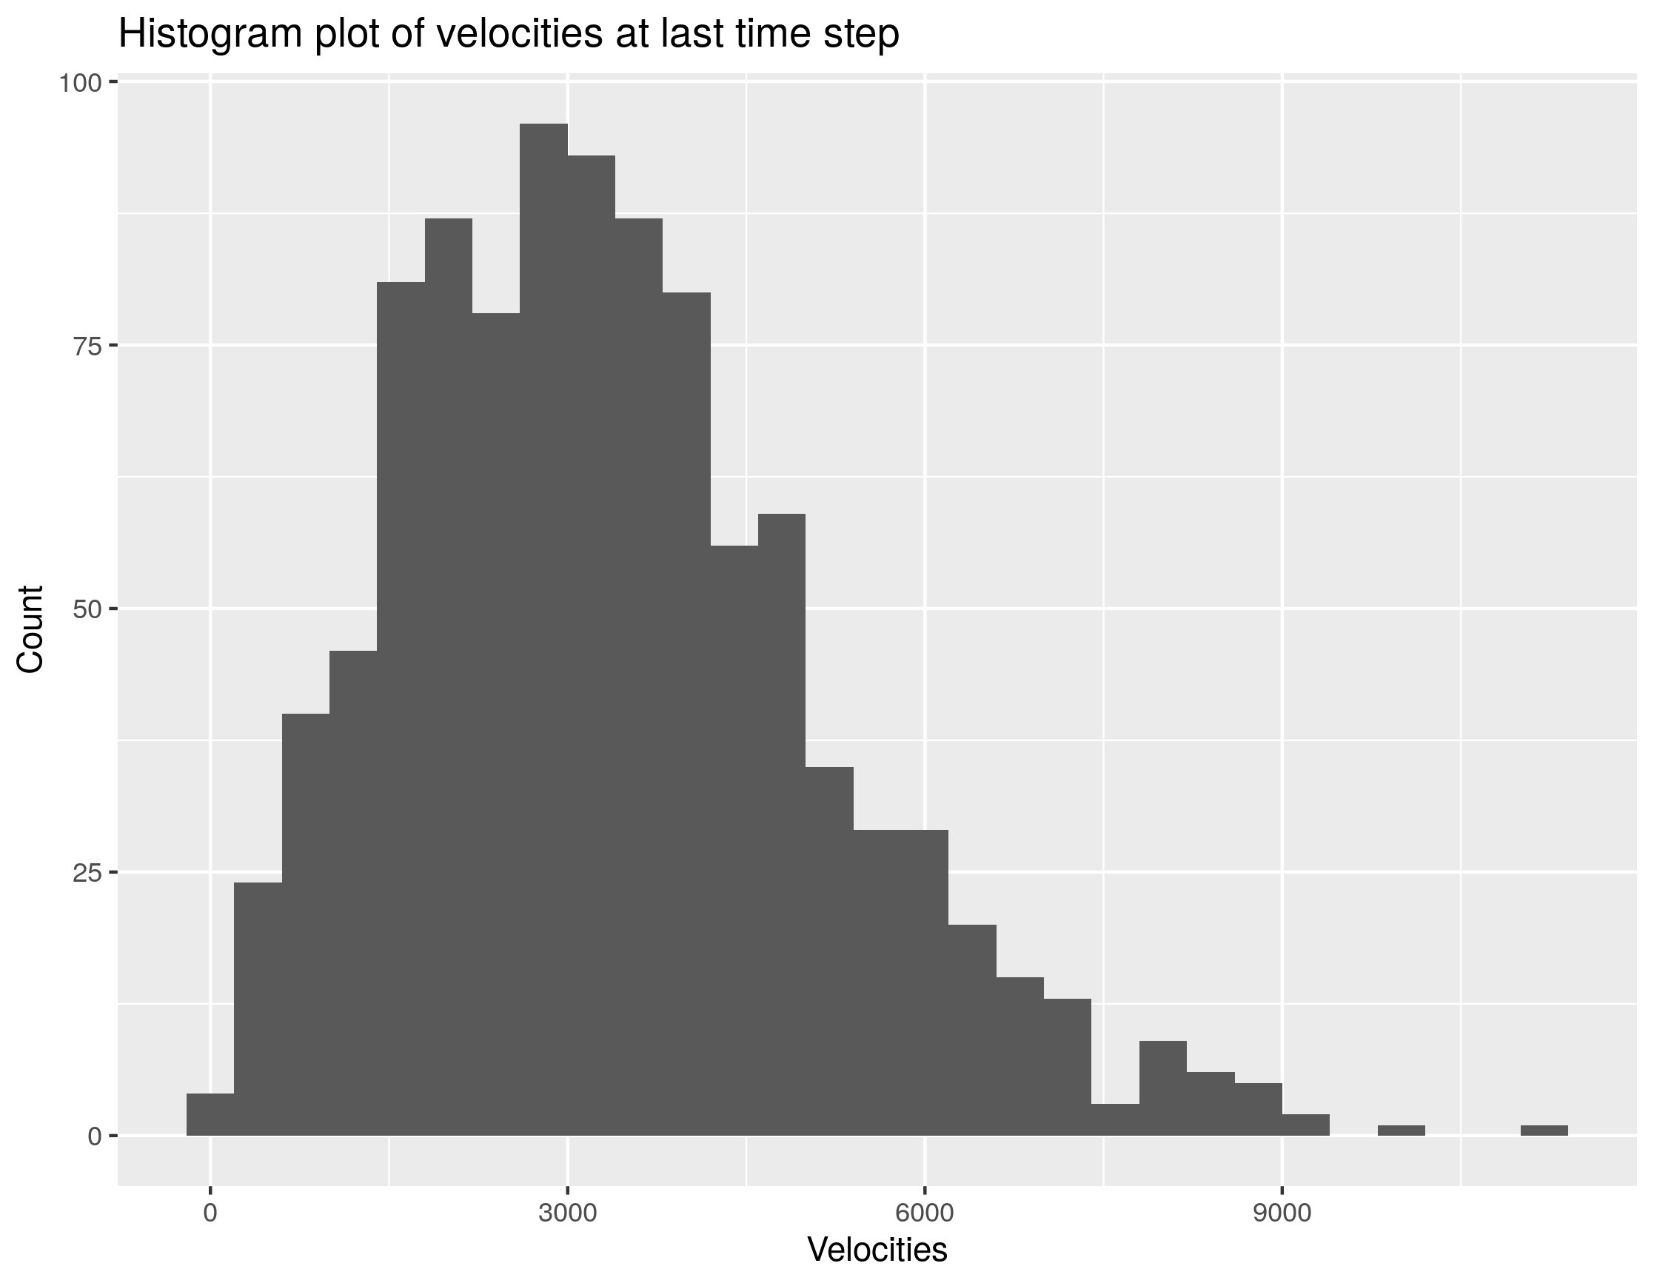






$$v_{limit}$$
$$v_{limit}$$
$$d$$
$$d=v_{limit}Δt$$
$$\sqrt{2}v_{limit}$$
$$v_{limit}$$

